Slide 1

“Inner GPS” system in the brain

Slide 2
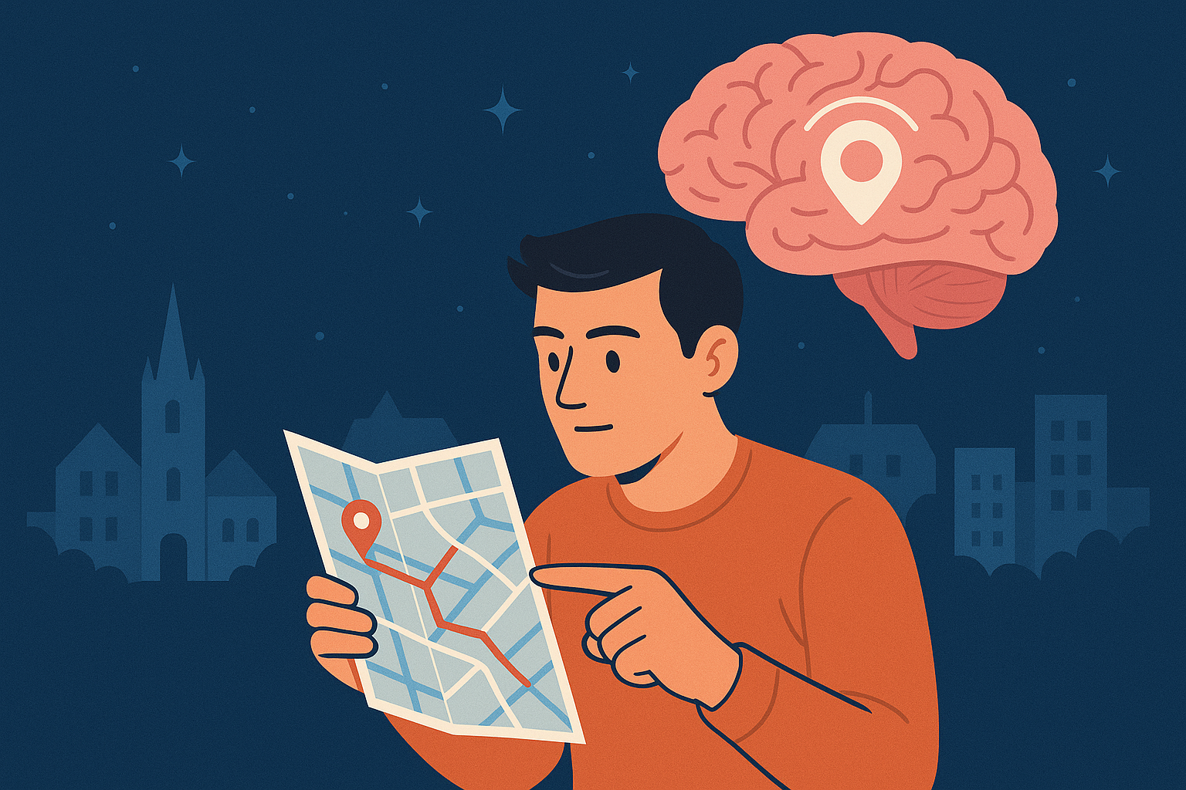
Generated with ChatGPT

Slide 3
Overview
01
02
03
Place Cells
Grid Cells
Relevance for Humans and Medicine

Slide 4
01
Place Cells

Slide 5
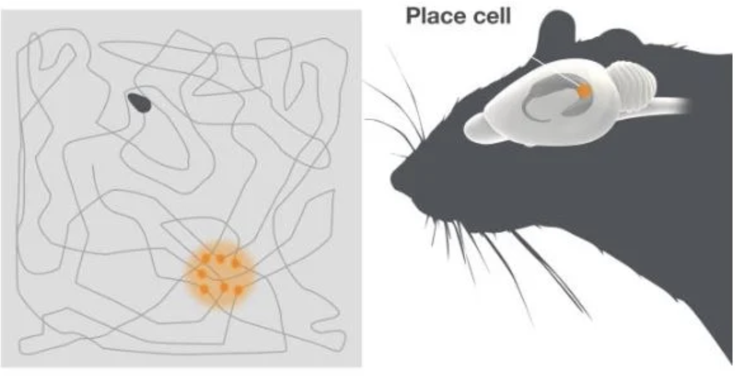
Place Cells
Source: https://www.nobelprize.org/prizes/medicine/2014/advanced-information/

Slide 6
Place Cells
Source: https://www.nobelprize.org/prizes/medicine/2014/advanced-information/

Slide 7
02
Grid Cells

Slide 8
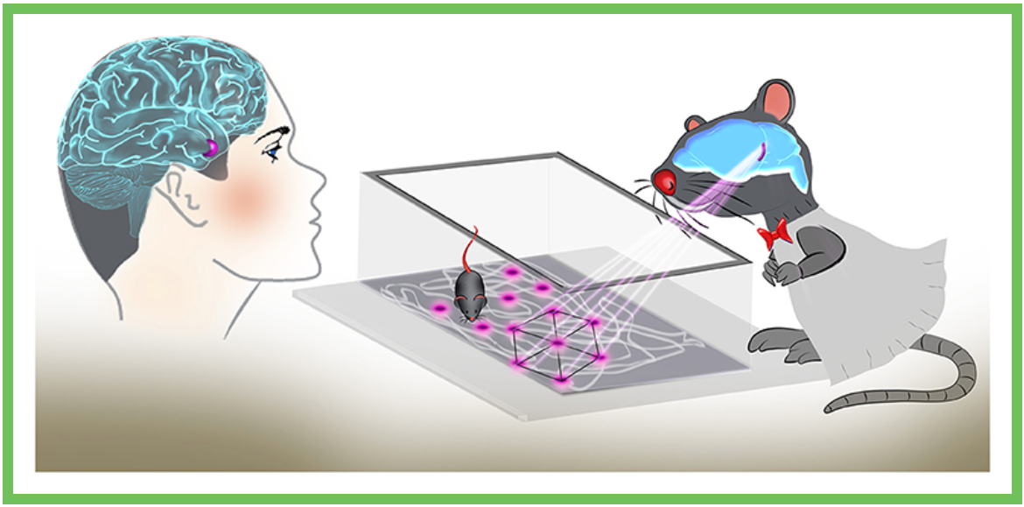
Grid Cells
Hexagonal grid
Coordinate system
Distance approximation
Source: https://kids.frontiersin.org/articles/10.3389/frym.2021.678725

Slide 9
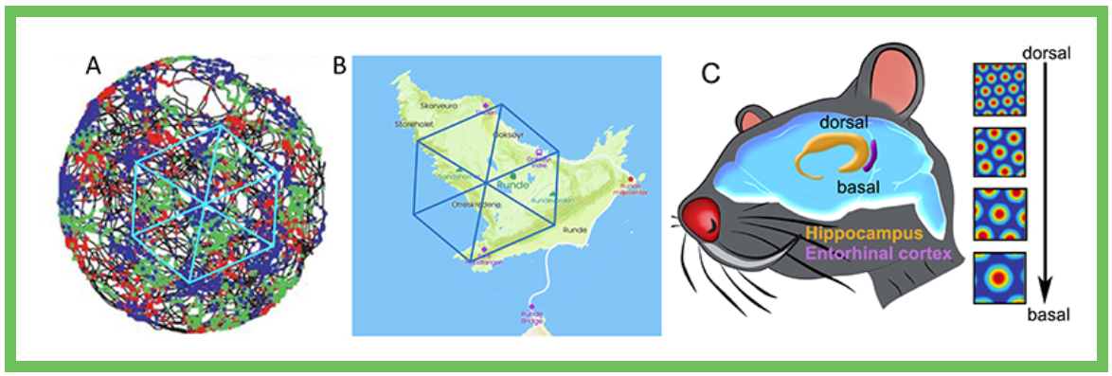
Grid Cells
Variety of cells
Source: https://kids.frontiersin.org/articles/10.3389/frym.2021.678725

Slide 10
Relevance for Humans and Medicine
03

Slide 11
Relevance for Humans and Medicine
Navigation
Spatial Memory
Orientation
Measuring distances
Impact on Alzheimer’s patients

Slide 12
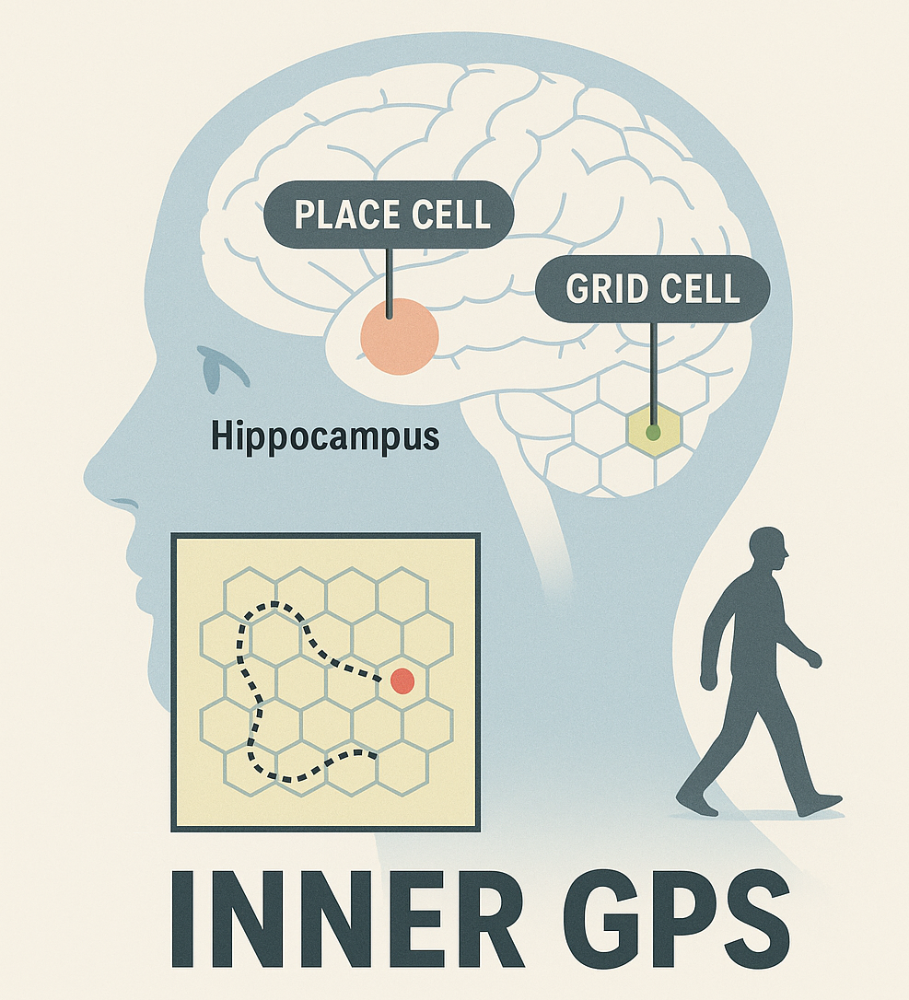
Generated with ChatGPT

Slide 13

Thank you!

Slide 14
Resources
https://www.nobelprize.org/prizes/medicine/2014/advanced-information/
https://kids.frontiersin.org/articles/10.3389/frym.2021.678725

